Slide 1
Institute of Bankers Professional Diploma in Banking Risk Economic & Regulatory Capital, Stress Testing and Provisions Topic Two The History of Basel and Risk Weighted Assets

Slide 2
Consistency across Portfolios & Banks
How do we compare risk across portfolios?
a first-time buyer mortgage with a corporate overdraft
Presumably some products by definition are less risky than others
Lower propensity to default or
Lower potential losses
How do we compare risk across banks?
Is one mortgage portfolio riskier than another?

Slide 3
Basel
Expected (average) Loss (EL) is part of the product price
Capital is for Unexpected Loss (UL)
Hold capital for unexpected credit losses at 99.9% confidence
This is a function of the quantum and riskiness of assets
Expected Loss
Loss Coverage Level
Probability
e.g. 99.90% confidence
Expected
Loss
Capital
Zero
Potential “Unexpected Losses”
Potential “Unexpected Losses”
Losses
for which Capital should be held
against which it would be too
expensive to cover with Capital

Slide 4
Expected Loss
Two concepts underpin a bank’s approach to quantifying credit risk. These are expected loss and unexpected loss.
Expected loss is the statistical average level of credit loss (a cost of doing business) through the economic cycle. The expected loss on an individual loan can be estimated by examining the loan as part of a portfolio of similar risks.
Expected loss recognises that lending necessarily involves bad debts. It is a foreseeable cost of being in the lending business and should be treated as any other cost. It is not a notional cost.
As such, expected losses are not a measure of risk. When measuring risk, it is uncertainty that is being measured. Thus, a measure of uncertainty is needed to measure credit risk.
This chart shows the typical loss experience of a bank over time and the consequential expected loss of the bank.
EL

Slide 5
Unexpected Loss
While the expected loss is a foreseeable cost of doing business, the unexpected loss is the true risk in lending (as investors view risk). Unexpected loss is the volatility around the expected loss and is measured by the standard deviation of the expected loss. The standard deviation is a symmetric measure of dispersion around the mean. The greater the dispersion around the mean, the greater the standard deviation and the greater the risk.
While the standard deviation gives an indication of the degree of dispersion around the mean, it does not suffice in terms of measuring credit risk. This is due to the asymmetric nature of credit losses. Put another way, the length of the “downside” tail in credit is much larger than the potential for upside. This is because with credit, the upside is “capped” at zero loss but there is much larger downside potential. Unexpected loss creates the requirement to hold capital.
UL
EL

Slide 6
Nature of Banking & Need for Capital
Loss rates are volatile from year to year but the expected loss can be predicted and is the average loss over an economic cycle
We need to take account of the variability of the loss rate over time.
Volatility differs from bank to bank depending on risk appetites , risk concentrations and risk practices.
How do we cope with this loss?
Expected Loss is the average loss
Notes:
Just a visual showing all that. From a capital perspective Again not worried about the average loss ( orange line) – know that we can price and provision for it.
Worried about the size of the variability around it.
That’s just am illustration - showing volatility / spikes in losses over a cycle
How might that look for if that was a retail portfolio vs a corporate portfolio ?
What drives volatility in portfolios? - assets / concentrations / correlations

Slide 7
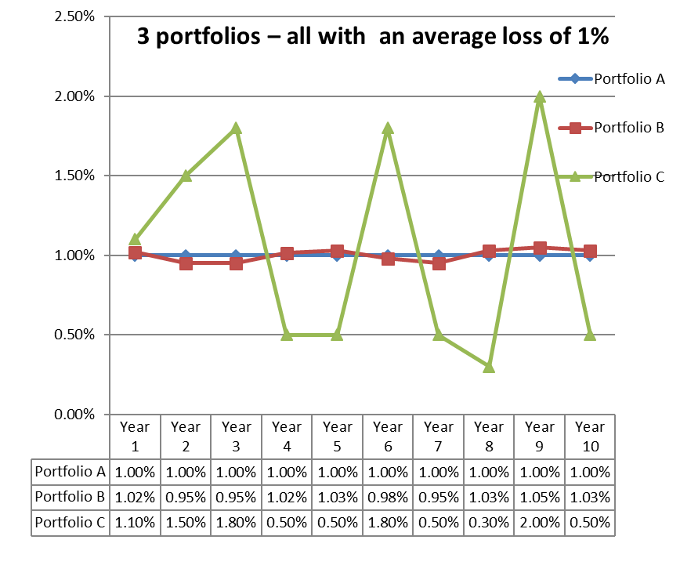
How Much Capital ?
The risk that banks face is not the average loss rate by itself but the variation around that loss rate. In this example 3 banks have 3 different debtor portfolios, each with 1% EL.
However - even though the 3 portfolios will suffer the same average losses, the greater this variation or uncertainty around the loss rate, the more capital that is required to be held – as there is a higher chance of extreme losses.
In this example a bank with debtors in “Portfolio C” has the greater need for a capital buffer to weather the storm in the bad years.
What influences the variation in losses and thus the capital levels required :
Risk taking appetite & policies
Risk management practices
Portfolio diversification

Slide 8
Simple Observations about Capital
Capital exists to provide a buffer to absorb unexpected losses
Buffer for Loss Absorption
To cope with higher than average / severe (1 in 1000 year) losses - protect against insolvency
Protect providers of finance to banks ( e.g. depositors) – shifting the cost of failure towards owners
Protect the stability of the financial system
Ensure market and public confidence in the financial system (well capitalised to cover risks)
Level of potential losses and therefore required capital depends on:
The level and type of risk a bank takes on
The volatility / extremes of losses the bank might experience
Bank’s risk appetite / risk policies / portfolio diversification and risk management
Regulatory Rules: Regulators impose minimum capital requirements (Capital Ratios)

Slide 9
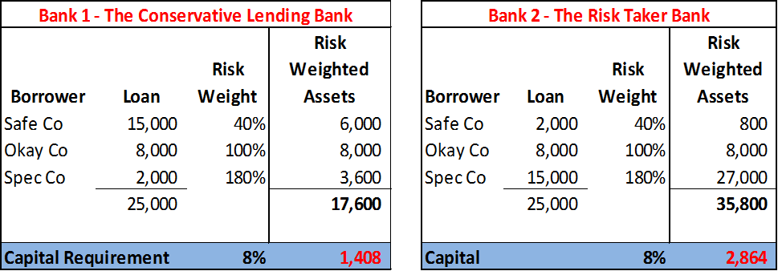
How Much Capital for Credit Risk?
The amount of capital to be held is determined by a measure of the riskiness of the loans / assets - which in turn reflects the risk appetite / risk policies / loss variation etc. of the bank
To facilitate this assets / loans are assigned a “risk weight” and converted to “Risk Weighted Assets” (RWAs) for capital purposes
Capital requirements are expressed in terms of capital ratios which link capital to be held to the risky assets on the balance sheet. By risk weighting an asset this puts more ‘weight’ and , as a consequence, requires banks hold more capital against riskier assets.
Banks are required to hold capital equal to a minimum % of Risk Weighted Assets. Minimum total capital ratio has historically been 8% for credit RWAs under Pillar I
RWA captures that Bank 1 below is safer than Bank 2 and needs less capital

Slide 10
Basel Regulation and Capital
The Basel Committee on Banking Supervision (BCBS)
Is the primary global standard-setter for the prudential regulation
Provides recommendations for regulations in the banking industry
Makes recommendations on risk measurement
Advises what counts as capital and how much capital is needed
The EU puts some or all of these recommendations into law via
EU Directives (Capital Requirements Directives - CRD I to IV)
Capital Requirements Regulation (CRR)
Including some areas of discretions for national authorities
EU capital directives are them transposed into national law. The EU regulations are directly applicable and do not require national transposition. The national authorities also issue implementation guides to set out where they have exercised their national discretion.

Slide 11
Basel One Approaches to Capital (Euro ‘88)
Provide a buffer against bank losses
Protect creditors in the event of bank fails
Creates disincentive for excessive risk taking
Basel I (1988, became effective on 1/1/1993)
Assets / loans are assigned a Risk Weight (RW) and converted to Risk Weighted Assets (RWA) for capital purposes
These are then added together to give total RWA for the bank
Banks are required to hold minimum regulatory capital equal to a minimum % of Risk Weighted Assets. Minimum total capital ratio is 8% (pre buffers, etc.)
There were five categories of RW: 0%, 10%, 20%, 50%, 100%
0%: Cash, Central Governments, Central Banks
20%: Banks
50%: Residential mortgages
100% Personal non-mortgage loans, commercial lending

Slide 12
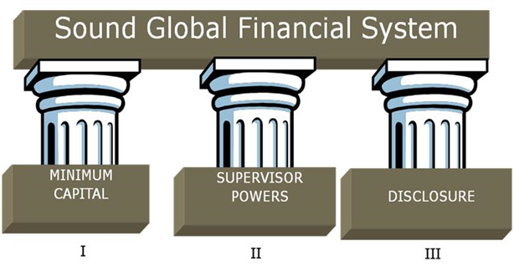
Basel Structure
Basel II introduced fundamental changes (2007 – 2013) and Basel III / CRD IV from 1 Jan 2014
Pillar 1: Minimum Capital Requirements for credit, operational and market risk - minimum capital ratios (e.g. 8% min capital) , determines qualifying capital and calculation of RWAs
Pillar 2: Supervisory Review Process - Improved supervisory review of financial institutions , addresses other risks not included in Pillar 1 (later – topic five)
Pillar 3: Disclosure - Impose market discipline through greater disclosure requirements

Slide 13
Risk Weighted Assets
Credit Risk RWAs
Standardised
Advanced
Internal Ratings Based (IRB)
Market Risk RWAs
Internal Model Approach
Operational Risk RWAs
Basic Indicator
Standardised
Counterparty RWAs
Internal Model Method
M2M
Foundation Internal Ratings Based (IRB)
Advanced Measurement
Standardised
Standardised
Org.
Exp
Increasing Sophistication

Slide 14
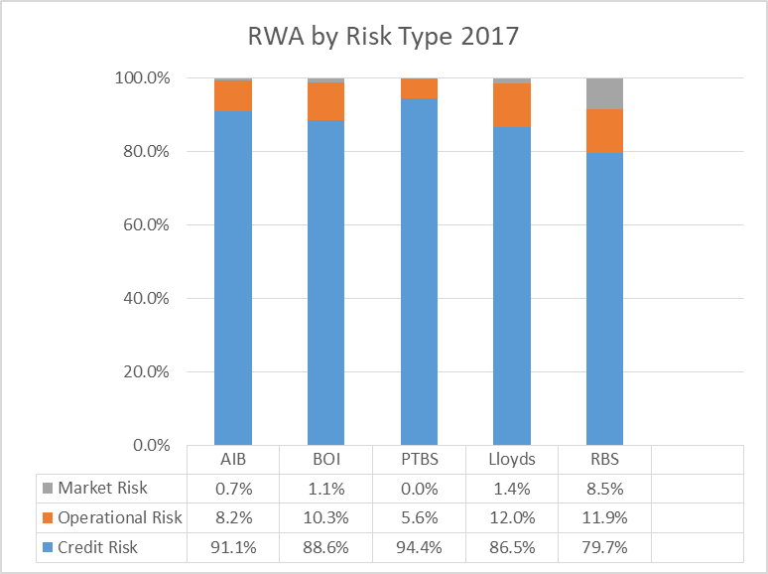
RWA distribution - Pillar 3 Disclosures (2017)
Credit Risk RWA typically 80% to 95% of total RWAs

Slide 15
AIB Risk Weights 2019 – Credit, Market & Op.
 | Risk weighted assets |  | Minimum capital requirements
 | 31 December 2019 | 31 December 2018 | 31 December 2019 | 31 December 2018
AIB Group | €m | €m | €m | €m
Credit risk (excluding counterparty credit risk) (“CCR”) | 45,108 | 44,815 | 3,609 | 3,585
Of which: |  |  | - | -
Standardised approach | 26,756 | 26,268 | 2,140 | 2,101
Foundation IRB (FIRB) approach | 13,775 | 12,945 | 1,102 | 1,036
Advanced IRB (AIRB) approach | 4,577 | 5,602 | 366 | 448
Equity IRB under the simple risk-weighted approach or the internal model approach ("IMA") | - | - | - | -
CCR | 1,003 | 1,301 | 80 | 104
Of which:
Mark to market | 541 | 568 | 43 | 45
Financial collateral comprehensive method (for SFTs) | 325 | 341 | 26 | 27
CVA ⁽²⁾ | 137 | 392 | 11 | 31
Settlement risk | - | - | - | -
Securitisation exposures in the banking book (after the cap) | 458 | 68 | 37 | 5
Of which:
IRB approach | 67 | 68 | 5 | 5
Securitisation external ratings based approach (SEC- ERBA) ⁽³⁾ | 391 | - | 31 | -
Market risk | 473 | 371 | 38 | 30
Of which:
Standardised approach | 473 | 371 | 38 | 30
Large exposures | - | - | - | -
Operational risk | 4,700 | 4,624 | 376 | 370
Of which:
Standardised approach | 4,700 | 4,624 | 376 | 370
Amounts below the thresholds for deduction (subject to 250% risk weight) | 379 | 417 | 31 | 34
Other risk exposure amounts | - | - | - | -
Floor adjustment | - | - | - | -
Total | 52,121 | 51,596 | 4,171 | 4,128

Slide 16
Basel II Pillar I Risk Weights
Basel II addressed the lack of granularity of risk measurement. It introduced three categories of bank / portfolio
Standardised
Foundation Internal Ratings Based (FIRB)
Advanced Internal Ratings Based (AIRB)
Standardised
Regulator supplies risk weights for all asset types
Internal models are not used for Pillar 1 calculations
Similar to Basel I but more granularity

Slide 17
Credit Risk Capital – Three Approaches
Sophistication level
Standardised Approach
Foundation Internal Rating Based (F-IRB)
Advanced Internal Rating Based (A-IRB)
The regulator supplies risk weights for all asset types on a look-up basis.
Internal models are not used for Pillar 1 calculations.
This is similar to Basel I , but is more onerous as there are increased definition criteria.
Institutions supply their own estimates of PD (to standards set by the regulator).
The regulator supplies look-up values for LGD , EAD and Maturity.
Institutions supply their own estimates of PD, LGD and EAD.
Retail IRB
Notes:
Basel II
3 approaches to calculation of credit risk capital
Range in sophistication - More sophisticated – approach – more rewarded by lower capital weight
Reason – much better understanding of risks – understand risk better r- can manage better –
Cant just take advanced approach - lower capital
Prove that you are closer to risks - meet minimum standards modelling , but more importantly show how risk and capital management is part of daily life

Slide 18
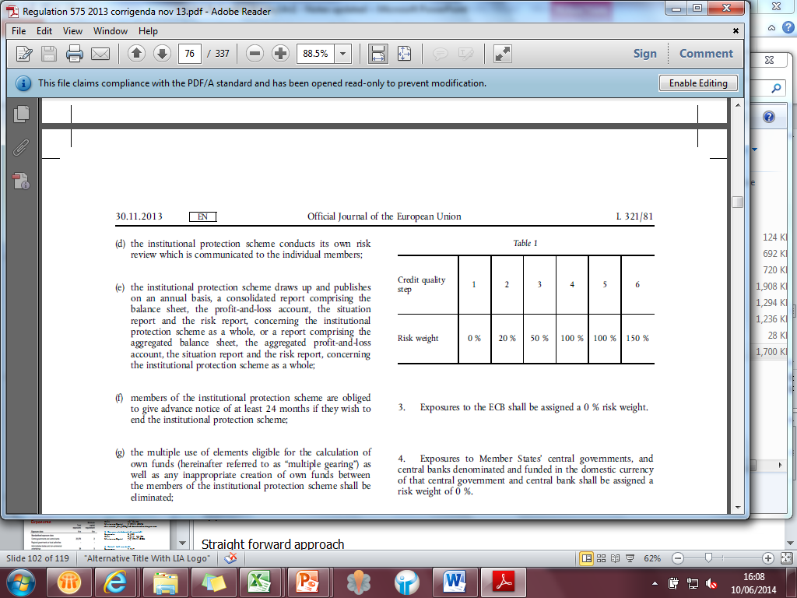
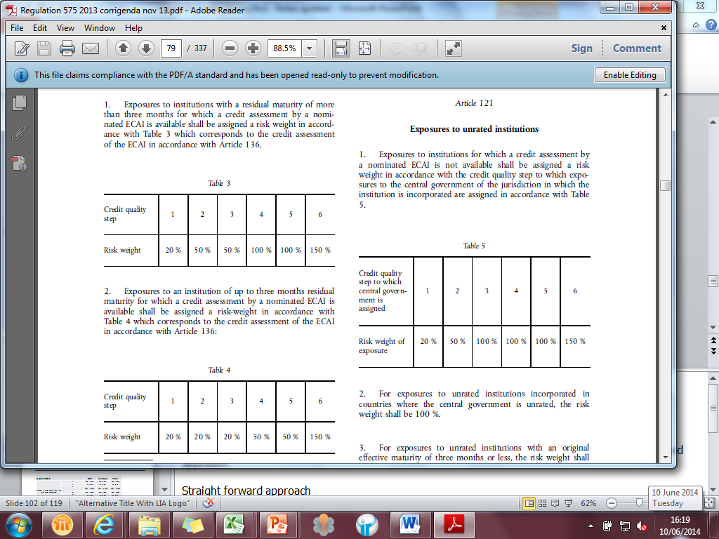
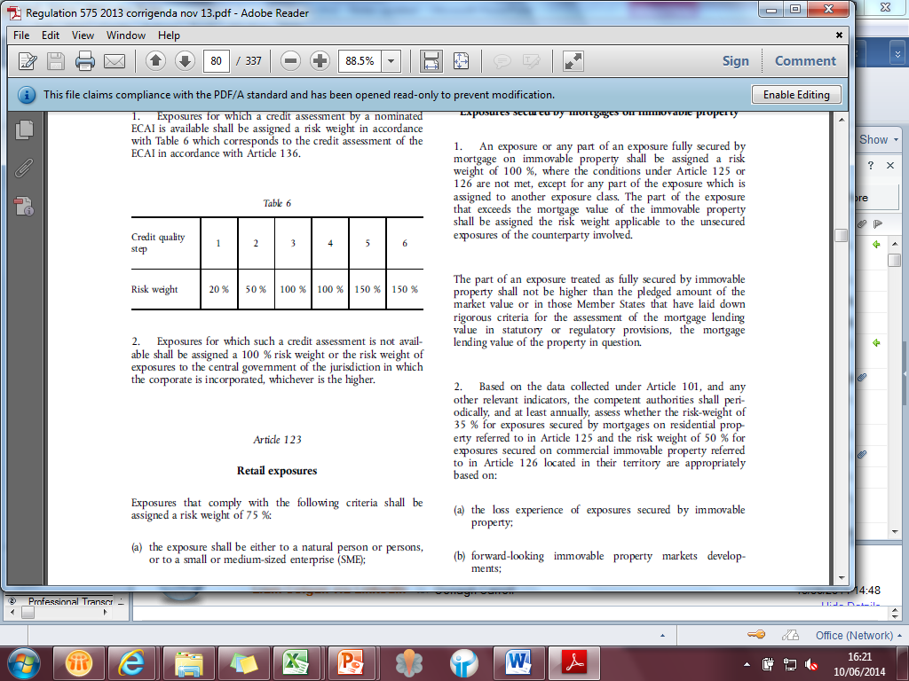
Basel II Standardised Non Retail
Sovereigns / Central Banks: 0% to 150%
Banks / Institutions: 20% to 150%
Corporate: 20% to 150%

Slide 19
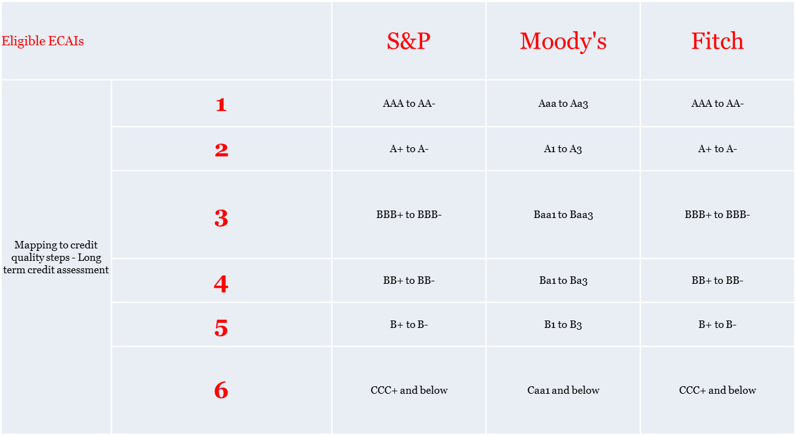
Standardised Basel II Risk Weights
Non-Retail: External Credit Assessment Institutions ECAI
Link RW to credit quality as assessed by ratings agencies

Slide 20
Retail Standardised in Basel II
Mortgages: RWA reduced from 50% to 35%
Commercial Real Estate: Remains at 100%
Other Retail Products: RWA is 75%
Defaulted Exposures: New risk weight thresholds
Mortgage 100% on unsecured portion
Other 100% to 150% - depending on provision level

Slide 21
Basel II - IRB Approach
Key elements to any IRB approach
Internal rating model
Risk components
Risk weight function
Minimum requirements of eligibility to apply the IRB approach
Supervisory reviews of compliance with the minimum requirement
PD (%)
Internal Ratings based on historical experience or credit scoring model
Lower bound 0.03%
EAD (€)
Exposure at default (not same as current exposure)
LGD (%)
Prescribed by regulator for non-retail (FIRB)
Internal estimates (AIRB)

Slide 22

EL and UL
Expected (average) Loss (EL) is part of the product price
EL = PD * LGD * EAD
€100K Mortgage has PD = 1%, LGD = 30%
EL = 1% * 30% * €100K = €300 (or 30 basis points)
Capital is for Unexpected Loss (UL) at at 99.9% confidence
RWA = 12.5 * K * EAD

Slide 23
Main Steps to Credit RWA Calculation
1 | Credit Asset | Identify all on and off balance sheet assets
2 | Exposure Class | Allocate to exposure class ( Sovereign / Bank/ Corp/ Retail/ Mortgage…)
3 | RWA Approach | Standardised or IRB - (can use different approaches for different portfolios e.g. Standardised for sovereign exposures / FIRB for Corporate – subject to rules)
4 | Exposure Value (EAD) | On Balance sheet Off Balance Sheet *CCF ( credit conversion factor)
5 | Risk Weight (RW) | Standardised Lookup Risk Weight depending on rating ( if rated) or default RW for unrated May need to look through rating to rating of guarantor,etc.
 |  | FIRB Use RW formula for relevant Assets Class Calculate PD input Look up applicable LGD / Maturity Calculated RW
 |  | AIRB / Retail IRB Use RW formula for relevant Assets Class Calculate PD / LGD / CCF input Identify maturity (topped / tailed) Calculate RW
 |  | All approaches Other relevant items such as SME discount / Financial sector scalar, etc

Slide 24
AIB YE 2019
 |  | 31 December 2019
 | Total exposures | Risk weighted assets | Minimum capital requirement CRD IV
AIB Group
IRB approach
Central governments or central banks | 7,645 | 52 | 4
Institutions | 18,408 | 2,234 | 179
Corporates | 15,582 | 11,960 | 957
Of which: Specialised lending | 904 | 601 | 48
SMEs | 3,959 | 3,842 | 307
Retail | 18,957 | 4,577 | 366
of which: Secured by real estate property | 18,957 | 4,577 | 366
Securitisation positions | 517 | 67 | 5
Other non credit obligations | 15 | 15 | 1
Total IRB approach ⁽¹⁾ | 61,124 | 18,905 | 1,512
Central governments or central banks | 12,447 | 115 | 9
Regional Government and Local Authorities | 209 | 1 | -
Public sector entities | - | - | -
Institutions | 712 | 14 | 1
Corporates | 11,361 | 9,141 | 731
Retail | 8,832 | 3,839 | 307
Secured by mortgages on immovable property | 17,934 | 9,699 | 776
Exposures in default | 1,226 | 1,389 | 111
Items associated with particularly high risk | 1,529 | 1,828 | 146
Equity exposures | 253 | 412 | 33
ERBA Securitisation positions | 405 | 391 | 32
Other exposures | 3,131 | 1,077 | 86
Total standardised approach ⁽²⁾ | 58,039 | 27,906 | 2,232
Total | 119,163 | 46,811 | 3,744
All figures in €m
IRB mortgages?
Personal lending?
Standardised mortgages?
IRB portion of book?
What should it be?
Read Pillar 3 report.

Slide 25
AIB Movements in RWA 2019
 | Credit risk STD | Credit risk IRB | Credit risk ERBA | Market risk | Operational risk | Credit valuation adjustment | Other | Total
AIB Group | €m | €m | €m | €m | €m | €m | €m | €m
Opening risk weighted asset | 26,993 | 19,216 | - | 371 | 4,624 | 392 |  | 51,596
Asset size ⁽¹⁾ ⁽²⁾ | 80 | 393 | 391 | 102 | - | 318 |  | 1,284
Asset quality ⁽³⁾ | (40) | (720) | - | - | - | - |  | (760)
Methodology and policy ⁽⁴⁾ | 14 | (424) | - | - | - | (573) |  | (983)
Model updates ⁽⁵⁾ | - | 339 | - | - | - | - |  | 339
Foreign currency movements | 468 | 101 | - | - | - | - |  | 569
Other | - | - | - | - | 76 | - |  | 76
Closing risk weighted asset | 27,515 | 18,905 | 391 | 473 | 4,700 | 137 |  | 52,121
 |  |  |  |  |  | 31 December 2018
 | Credit risk STD | Credit risk IRB |  | Market risk | Operational risk | Credit valuation adjustment | Other | Total
AIB Group | €m | €m |  | €m | €m | €m | €m | €m
RWAs CRDIV as at 31 December 2017 | 27,443 | 18,876 |  | 360 | 4,248 | 796 | 5 | 51,728
Asset size ⁽¹⁾ ⁽²⁾ | (465) | 1,159 |  | 11 | - | (8) | - | 697
Asset quality ⁽³⁾ | 68 | (612) |  | - | - | - | - | (544)
Methodology and policy ⁽⁴⁾ | - | (313) |  | - | - | (396) | - | (709)
Foreign currency movements | (53) | 106 |  | - | - | - | - | 53
Other | - | - |  | - | 376 | - | (5) | 371
RWAs CRDIV as at 31 December 2018 | 26,993 | 19,216 |  | 371 | 4,624 | 392 | - | 51,596

Slide 26
Explanations to previous slide
Notes as per numbers:
⁽¹⁾ Asset size increases/decreases in credit risk driven by new lending offset by loan redemptions, restructures, asset sales and write-offs.
⁽²⁾ Credit valuation adjustment reduction driven by the movement in derivative mark to market.
⁽³⁾ Asset quality represents the impact of PD and LGD migration changes within the loan book (also net movement into/out of default).
⁽⁴⁾ Relates to use of credit risk mitigation per article 453 and the application of own funds requirements for exposures to a central counterparty per section 9, chapter 6, Title II, Part three of the CRR. 2018 relates to the impact of the introduction of derivative netting
⁽⁵⁾ Increase in RWAs of Corporate SME following PD recalibration.
22nd April 2021
Notes:
e - All material aspects of the rating and estimation processes must be approved by the bank’s board of directors or a designated committee thereof and senior management.
These parties must possess a general understanding of the bank’s risk rating system and detailed comprehension of its associated management reports.

Slide 27
AIB Capital at YE 2019
https://aib.ie/content/dam/aib/investorrelations/docs/resultscentre/pillar3/aib-2019-pillar-3-report.pdf
Pillar III Report – Page 16. It’s a far cry from 8%.
The table sets out the capital requirements at 31 December 2019 and also the pro-forma requirements for 2020 and 2021 based on information available as at 31 December 2019. The table does not include Pillar 2 Guidance (“P2G”) which is not publicly disclosed.

Slide 28
New Capital Buffers Introduced Post Crisis
Create buffers in good times (strong economic performance with low default rates) that can be used in a downturn (phased in by January 2019)
Capital Conservation Buffer: Should be available to absorb banking sector losses conditional on a plausible severe stressed financial and economic environment – additional 2.5%
Countercyclical Buffer: Extends capital conservation range during periods of excess credit growth or other indicators deemed appropriate by supervisors for their national contexts – add 0 – 2.5% at the supervisor’s discretion – set at 1% for Irish institutions in 2019
Note: should an institution breach these combined buffer requirements, prepare a capital conservation plan within five days, submit to the national authority for approval
22nd April 2021

Slide 29
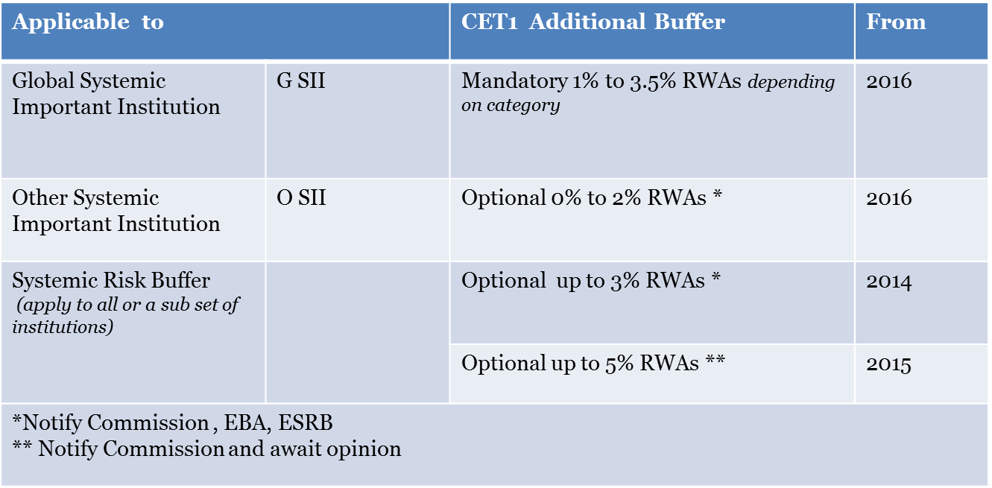
Other New Capital Buffers
Who is on the G-SII list today?
22nd April 2021

Slide 30
Credit risk – IRB Minimum Standards
Compliance with the use test (evidence that the IRB framework is used to manage the business)
Robust rating systems and risk estimates
Use of internal ratings and loss estimates
Independent credit risk control unit
Accurate, complete and appropriate data controls
Comprehensive documentation
Corporate governance and oversight
Appropriate adjustments for medium term volatility through the economic cycle
22nd April 2021

Slide 31
Is it Working?
https://assets.gov.ie/6836/664f5174ebd34f7e938aea654bed6757.pdf
Risk Weighted Assets in Ireland The Link to Mortgage Interest Rates
Consider graph on Page 16
What is going wrong?

Slide 32
EBA TRIM
The Targeted Review of Internal Models (TRIM) is aimed at enhancing the credibility and confirming the adequacy and appropriateness of approved Pillar I internal models permitted for use by significant institutions when calculating own funds requirements. As a major objective, TRIM focuses on the reduction of unwarranted variability in risk-weighted assets (RWA) driven by inappropriate modelling which takes advantage of the freedom granted by the current regulation.
Inspections 2017: Mortgages
Inspections 2019: Large Corporates

Slide 33
Example: Article 178 - Default (Bold is me!)
Article 178 Default of an obligor:
A default shall be considered to have occurred with regard to a particular obligor when either or both of the following have taken place:
the institution considers that the obligor is unlikely to pay its credit obligations to the institution, the parent undertaking or any of its subsidiaries in full, without recourse by the institution to actions such as realising security;
the obligor is past due more than 90 days on any material credit obligation to the institution, the parent undertaking or any of its subsidiaries. Competent authorities may replace the 90 days with 180 days for exposures secured by residential or SME commercial real estate in the retail exposure class, as well as exposures to public sector entities).
In the case of retail exposures, institutions may apply the definition of default laid down in points (a) and (b) of the first subparagraph at the level of an individual credit facility rather than in relation to the total obligations of a borrower:

Slide 34
Continued
The following shall apply for the purposes of point (b) of paragraph 1:
For overdrafts, days past due commence once an obligor has breached an advised limit, has been advised a limit smaller than current outstanding, or has drawn credit without authorisation and the underlying amount is material;
An advised limit comprises any credit limit determined by the institution and about which the obligor has been informed by the institution;
Days past due for credit cards commence on the minimum payment due date
Materiality of a credit obligation past due shall be assessed against a threshold, defined by the competent authorities. This threshold shall reflect a level of risk that the competent authority considers to be reasonable;
https://eur-lex.europa.eu/legal-content/EN/TXT/PDF/?uri=CELEX:32013R0575&from=EN
(There are 521 articles in CRR)

Slide 35
Reading: EBA Guidelines on IRB Risk Parameters
https://www.eba.europa.eu/sites/default/documents/files/documents/10180/2033363/6b062012-45d6-4655-af04-801d26493ed0/Guidelines%20on%20PD%20and%20LGD%20estimation%20%28EBA-GL-2017-16%29.pdf?retry=1
These guidelines are focused on the definitions and modelling techniques used in the estimation of risk parameters for both non-defaulted and defaulted exposures, whereas other regulatory products developed in the review process will clarify other aspects related to the application of the IRB Approach.
The EBA considers these clarifications and harmonisation necessary to achieve comparability of risk parameters estimated on the basis of internal models, and to restore trust in these models by market participants while at the same time preserving risk sensitivity of capital requirements.
Over 100 pages of guidelines
Reading – Summary EBA Guidelines on IRB Risk Parameters is the shortest comprehensive outline I can find.

Slide 36
Reading: Basel III Reforms Summary
The revisions seek to restore credibility in the calculation of risk-weighted assets (RWAs) and improve the comparability of banks’ capital ratios by:
Enhancing the robustness and risk sensitivity of the standardised approaches for credit risk, credit valuation adjustment (CVA) risk and operational risk
Constraining the use of the internal model approaches, by placing limits on certain inputs used to calculate capital requirements under the internal ratings-based (IRB) approach for credit risk and by removing the use of the internal model approaches for CVA risk and for operational risk
Introducing a leverage ratio buffer to further limit the leverage of global systemically important banks (G-SIBs)
Replacing the existing Basel II output floor with a more robust risk-sensitive floor based on the Committee’s revised Basel III standardised approaches

Slide 37
Basel III Reforms Introduction
RWA Changes
Revisions to standardised approach for credit risk 1 January 2022
Revisions to IRB framework 1 January 2022
Revisions to operational risk framework 1 January 2022
Output Floor – Original Deadlines
1 January 2022: 50%
1 January 2023: 55%
1 January 2024: 60%
1 January 2025: 65%
1 January 2026: 70%
1 January 2027: 72.5% (Pushed out one year I believe!)

Slide 38
Next Reading: EBA Opinion on DNB Article 458
On 8 January 2020, the EBA received notification from the Central Bank of the Netherlands (De Nederlandsche Bank – DNB) of its inntention to apply measures referred to in Article 458(2)(d)(vi) of the CRR ….(EBA-Op-2020-03) as follows for mortgages:
Minimum 12% risk weight for LTV component below 55%
45% risk weight on the remainder of the exposure
Applied at account level
https://www.eba.europa.eu/sites/default/documents/files/document_library/Publications/Opinions/2020/872842/EBA-2020-Op-04%20-%20EBA%20Opinion%20on%20measures%20taken%20by%20Belgium%20in%20accordance%20with%20Art%20458.pdf
Belgians concur (link above) and using a different methodology
Add 5% and multiply new answer by 1.33
Example: RW = 10%: add 5% = 15% x 1.33 = 20% or double original!

Slide 39
Biggest Influences
Include conservatism for data, modelling, etc
Calibrate PD to long run average
Calibrate LGD to long run average
Each of above is done at pool or grade level
Use Downturn LGD for estimating loss
Models must pass Use Test

